Slide 1


Intro to Network Protocols
NETPIE R&D TEAM
NECTEC

Slide 2
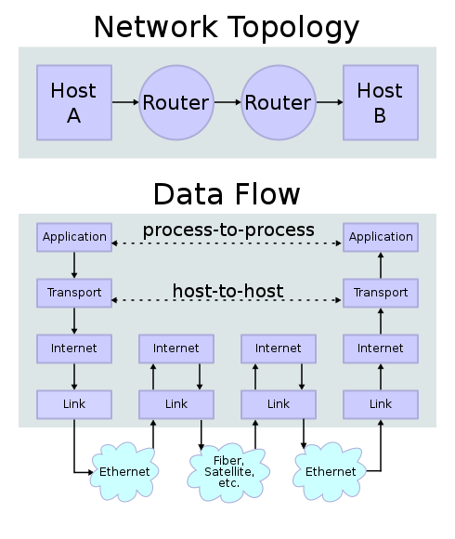
TCP/IP Communication

Slide 3

TCP/IP
Application Layer
HTTP, HTTPS, FTP, Mail, DNS, MQTT
Transport Layer
TCP, UDP
Internet Layer
IPv4, IPv6
Data Link Layer
Ethernet, WiFi, Bluetooth, Zigbee, …
Physical Layer
Copper, Fiber, Satellite, Wireless, …

Slide 4
IoT Application-Layer Protocols
NETPIE Supports
MQTT
AMQP
HTTP
CoAP

Slide 5
HTTP client-server model

Slide 6
HTTP (Web)
Web page
HTTP Request
HTTP Response
HTTP Request
Web Server
Web page
HTTP Response

Slide 7


HTTP
HTTP Request
HTTP Response
HTTP Request
Server
HTTP Response

Slide 8
HTTP
22 C
HTTP Request
HTTP Response
HTTP Request
Server
22 C
HTTP Response

Slide 9
MQTT publish-subscribe model

Slide 10
MQTT

Slide 11
MQTT Routing – Topic based
myhome/floor1/bedroom/temp
myhome/floor1/
bedroom/temp
myhome/floor1/
bedroom/temp

Slide 12
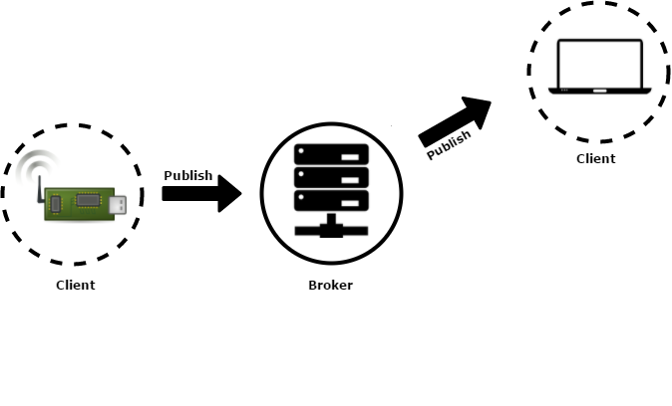
MQTT – Retained Messages
22 C
22 C
Retain = True
A MQTT client can publish a retained message by setting
Retain Flag to True in the PUBLISH packet.

Slide 13
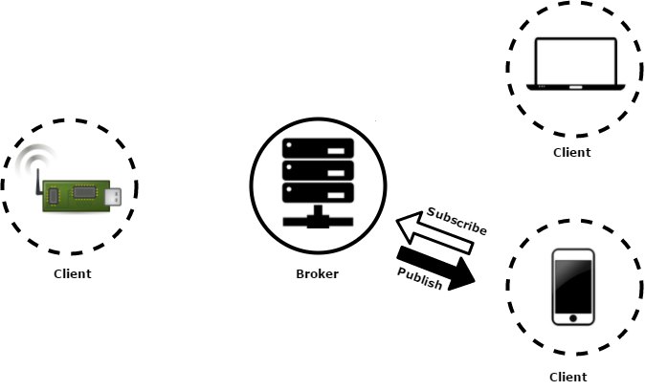
MQTT – Retained Messages
22 C
A client who subscribes to a topic with a
retained message would get sent the message
immediately after subscription.

Slide 14
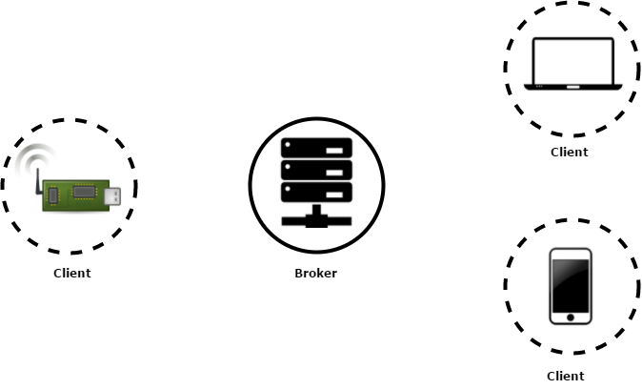
MQTT – Last Will
Unwillingly
disconnected!!!
A client can establish the connection
with the broker with “last will” message
attached to its CONNECT packet.

Slide 15
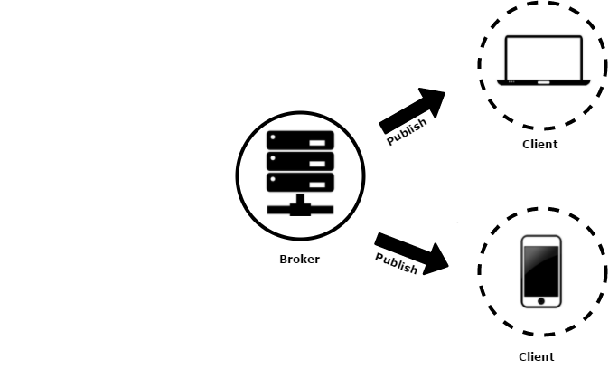
MQTT – Last Will
Last will
Last will
When it is disconnected unintentionally,
the broker will publish its last will to
the other clients.

Slide 16
Why MQTT
Asynchronous communication
Small code footprint
Saving network bandwidth – small header

Slide 17
MQTT - QoS
QoS 0 – At most once
Least reliable
Fastest
No acknowledgment
QoS 1 – At least once
One loop of acknowledgment
QoS 2 – Exactly once
Most reliable
Slowest with the largest headers
Two loops of acknowlegment

